Slide 1


Al-Karkh University for Science
Collage of Science
Medical Physics Department
General Biology II
" Practical"
Prepared by
Dr. Hiba Shakir Ahmed Dr. Rawa Abdul Redha Aziz
Ph.D Microbiology/Immunity Ph.D Antibiotic Molecular Biology

Slide 2
Porifera
LAB ((7))

Slide 3
Porifera
A sponge is a member of the phylum Porifera. It is a simple animal with many cells, but no mouth, muscles, heart or brain. It is sessile .
The basic body plan is a jelly-like layer sandwiched between two thin layers of cells. Their bodies are full of pores and channels allowing water to circulate through them. Most of them feed on bacteria and other microorganisms. A few of them eat tiny crustaceans.
There are more than 10,000 species of sponge. Most sponges live in the ocean. A few live in fresh water. All sponges take in water through pores (little holes) in their bodies. The water goes out through a big tube in the center. Most sponges filter (take out) little bits of food from the water going through their bodies. Animals that get food this way are called filter feeders.

Slide 4
Movement
Sponges they are fixed to the ground. A few sponges can change their position, they can move at speeds of between 1 mm and 4 mm a day. They do this like amoebae. A few species can contract their whole bodies. Many can close their openings/holes.
Reproduction in Sponges
Asexual reproduction
Sponges usually reproduce (make more of their kind) when little pieces break off. If such a piece has the right types of cells it can grow to become a new sponge. A few sponges can also use budding. With budding a small sponge grows on the parent; when it is done growing, it simply falls off. When the conditions are bad, some sponges can also grow lumps of unspecialised cells. These will not develop until the conditions improve again. They can then either make a new sponge, or they can use the skeleton of the parent sponge (that died).

Slide 5

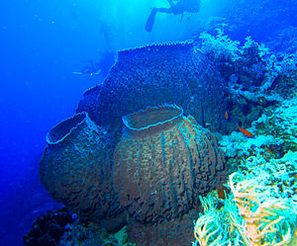
Sexual reproduction
Most sponges reproduce sexually. They can make sperm cells that are released into the water. These are either captured by another sponge, and are then transported to the egg cells of the parent. This is known as viviparous. Both cells are joined to form larvae, which can swim off to find a good place to settle.
The other way, known as oviparous is that both sperm cells and egg cells are released into the water. These then combine outside the sponges.
Scientific classification
Domain:Eukaryota
Kingdom:Animalia
Subkingdom:Parazoa
Phylum: Porifera

